Slide 1

Simple Electronics

Slide 2
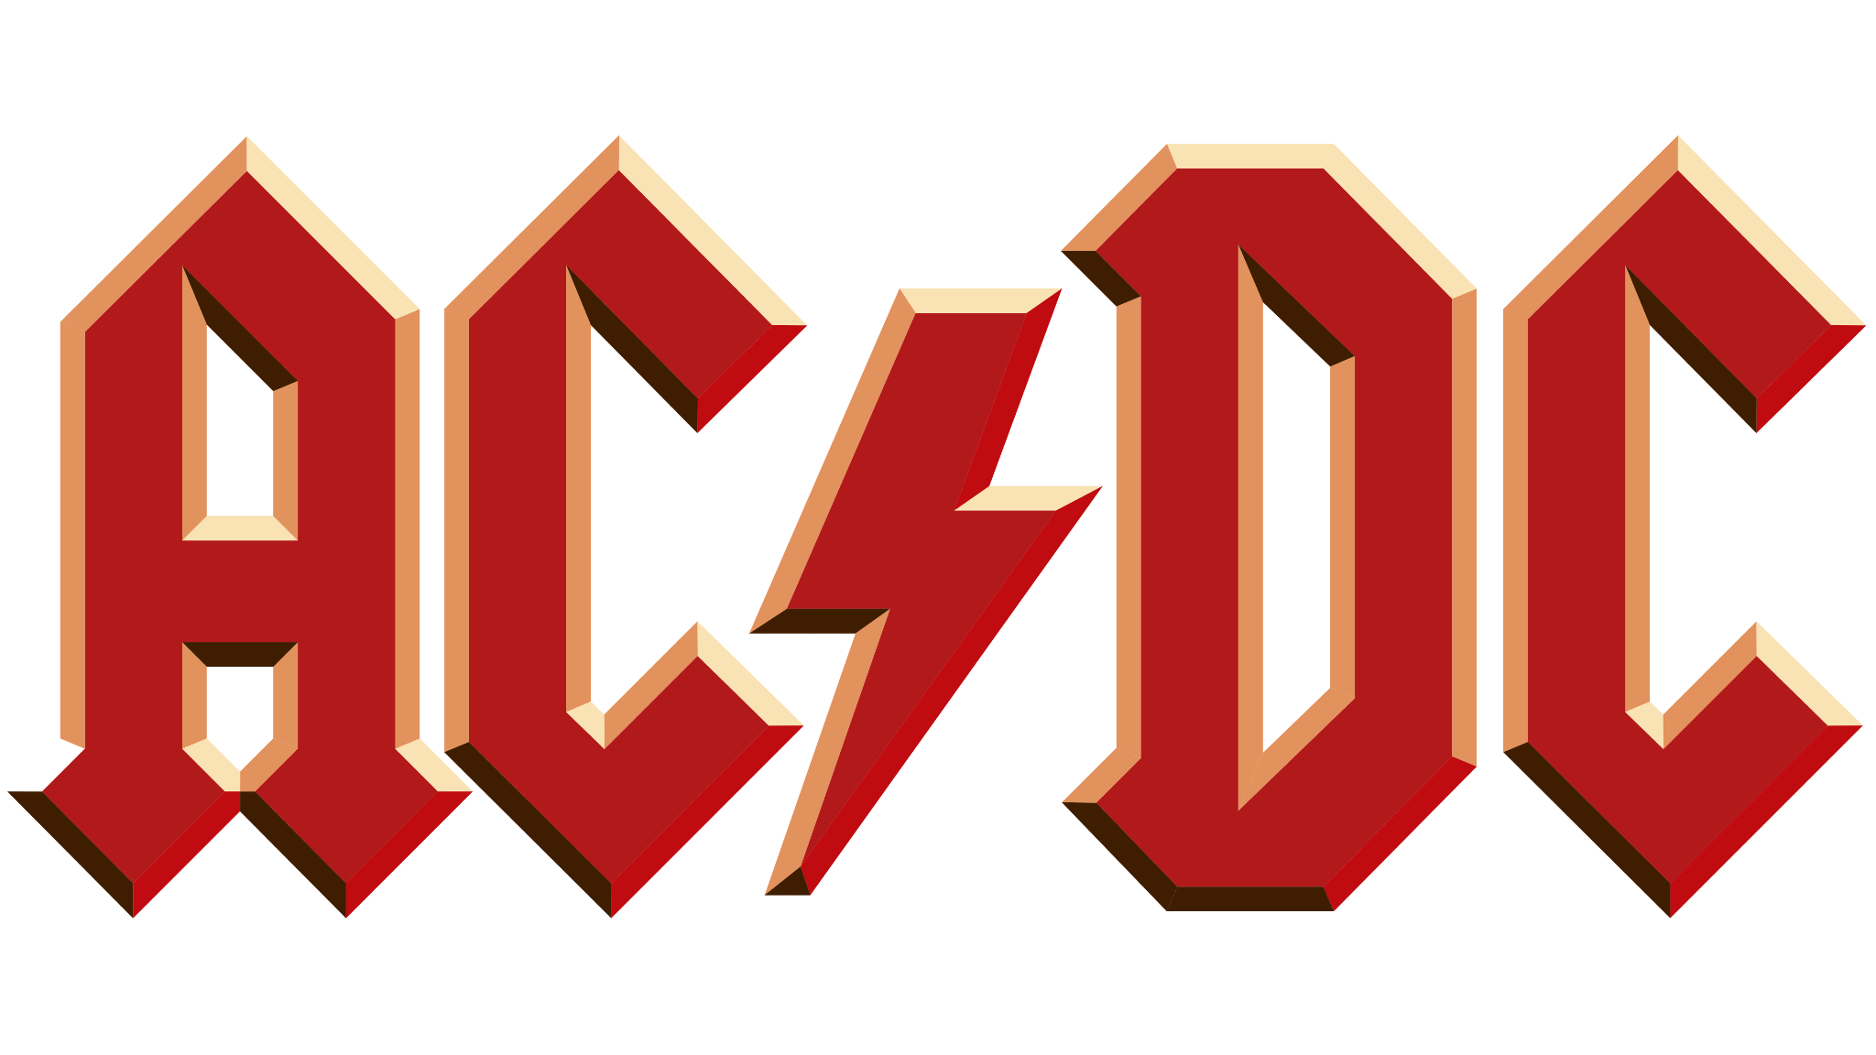
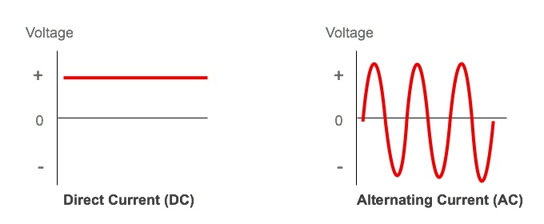
AC/DC
Electricity has two forms Alternating Current and Direct Current. As the name says alternating current alternates the negative and positive sides in a circuit, as a certain frequency, in direct current the sides do not oscillate, they stay on one side.

Slide 3
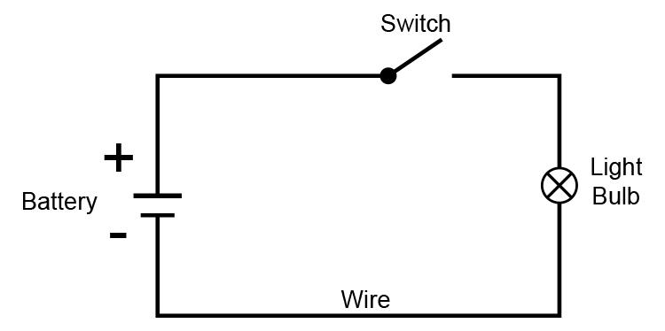
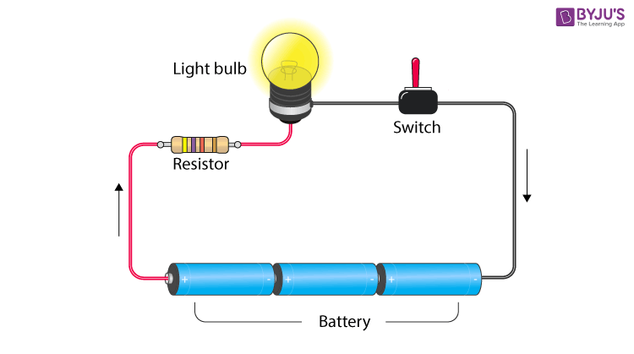
Circuits
Electricity flows from the positive to the negative terminal, or ground.
If the circuit isn’t closed then the electricity won’t flow. Like if a water pipe sistem had a leak, then the water wouldn’t arrive to the destination.
https://www.geeksforgeeks.org/rules-for-variable-declaration-in-java/

Slide 4
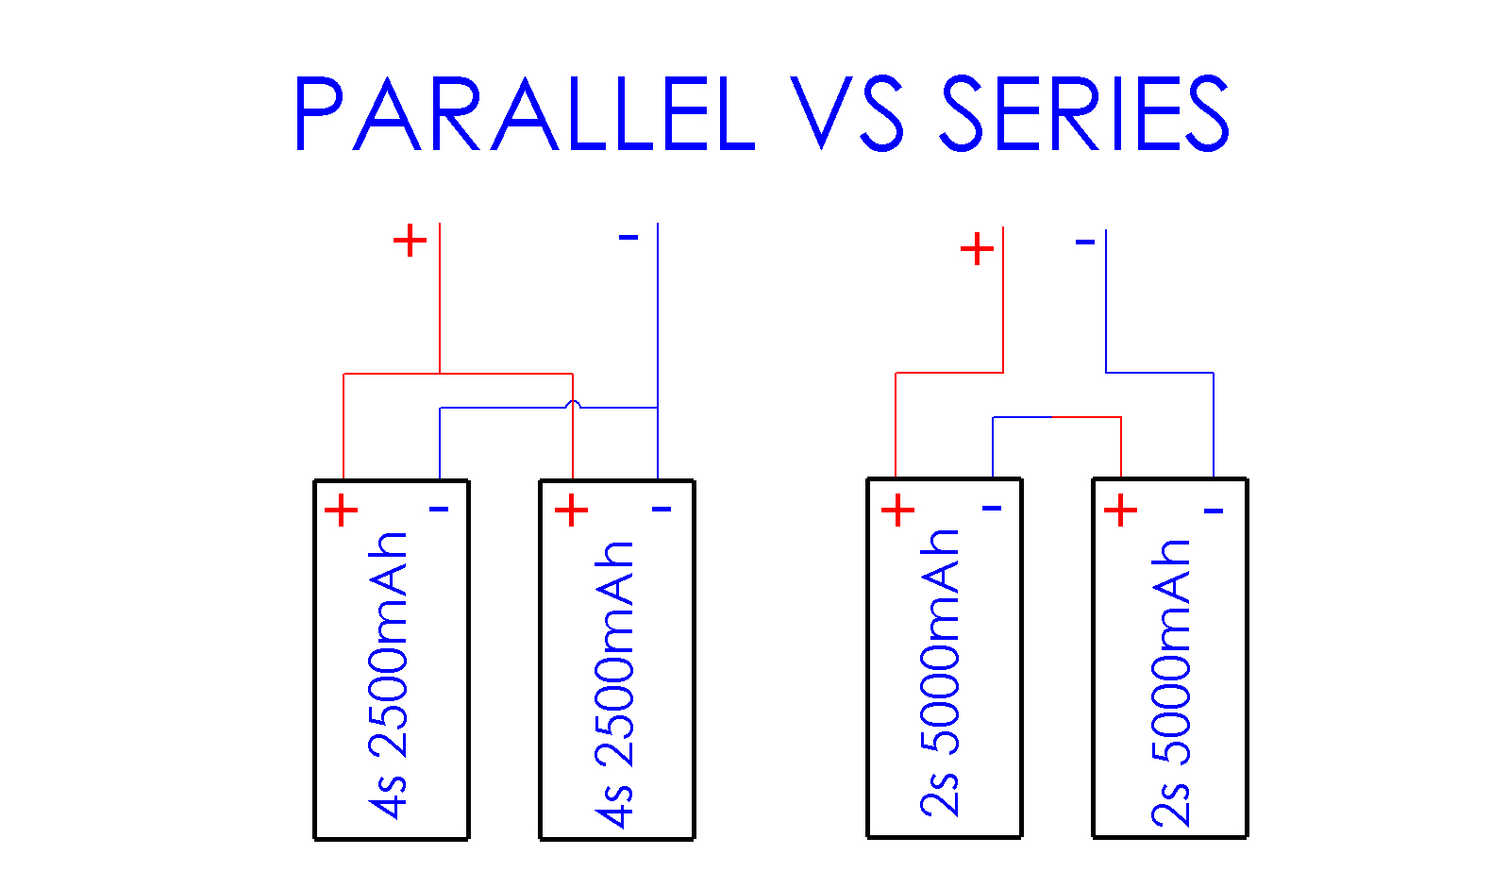
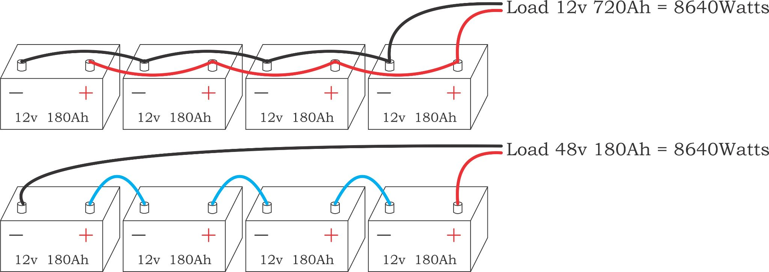
Series and parallel
Circuits can be set up in 2 ways: in parallel or in series, as the names refer series is one after the other, the positive of one things to the negative of the other and repeat, the parallel has all the positive connected to one another same with the negatives.
With power supplies the voltage is added in series and in parallel the current is added.

Slide 5
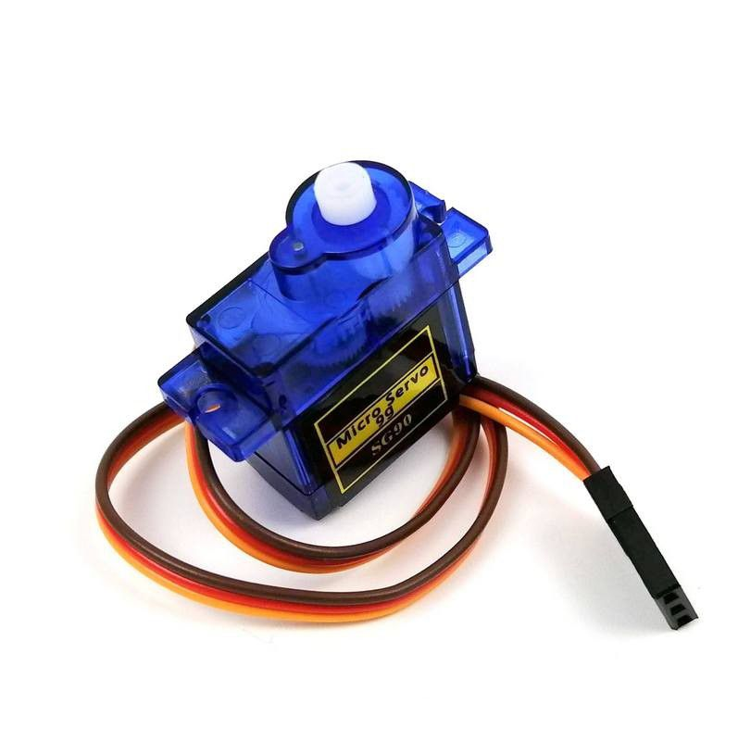
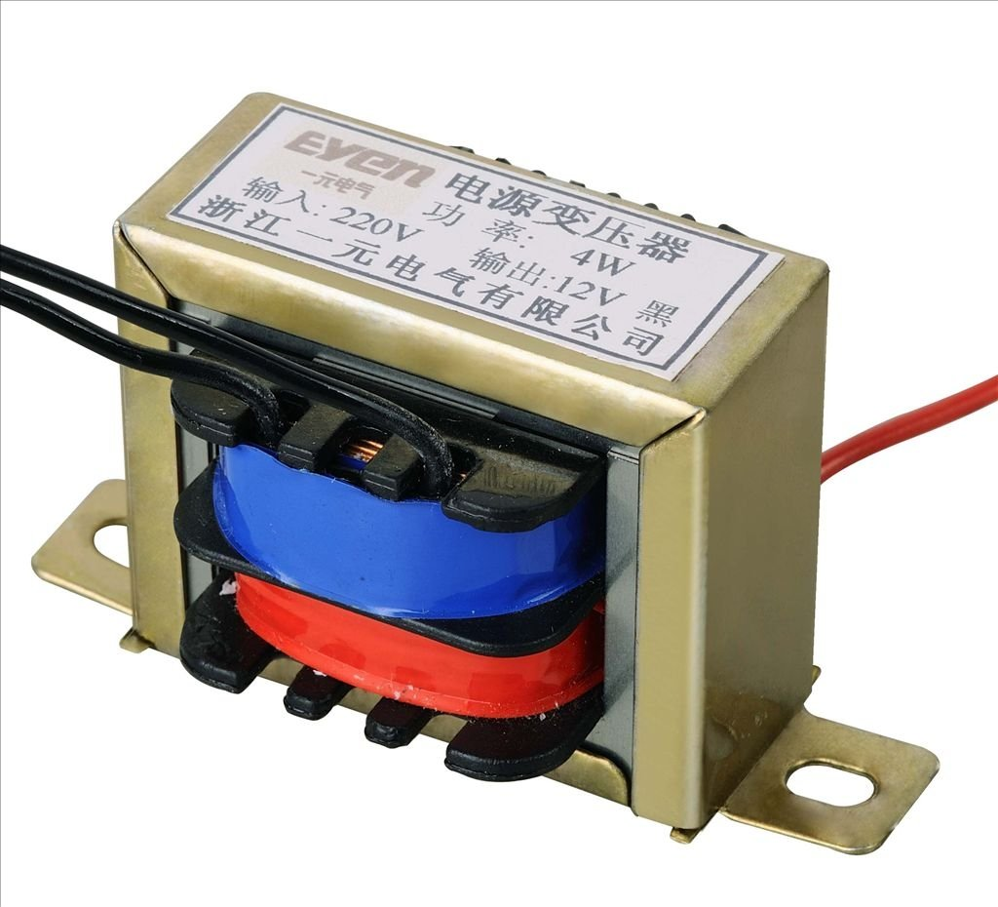
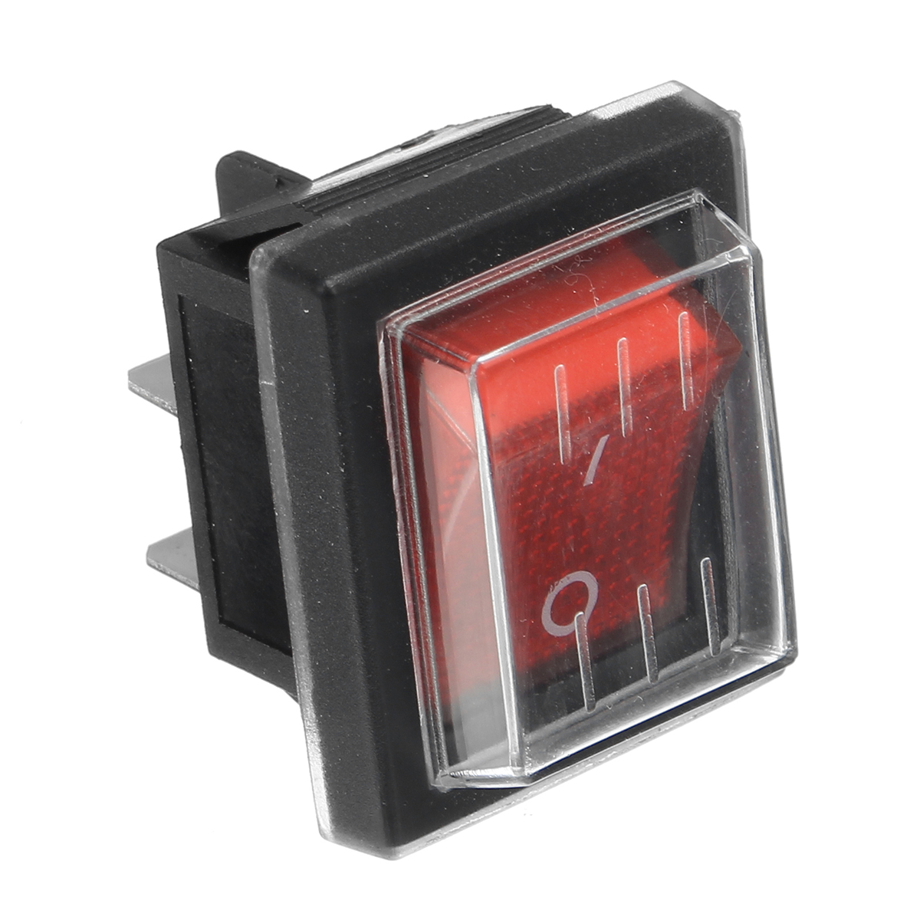
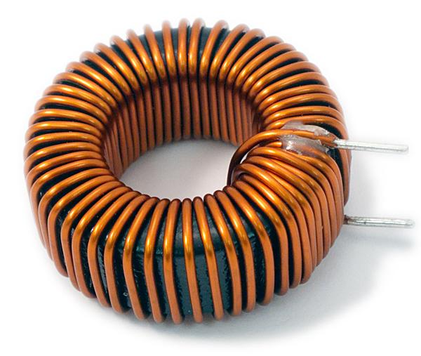
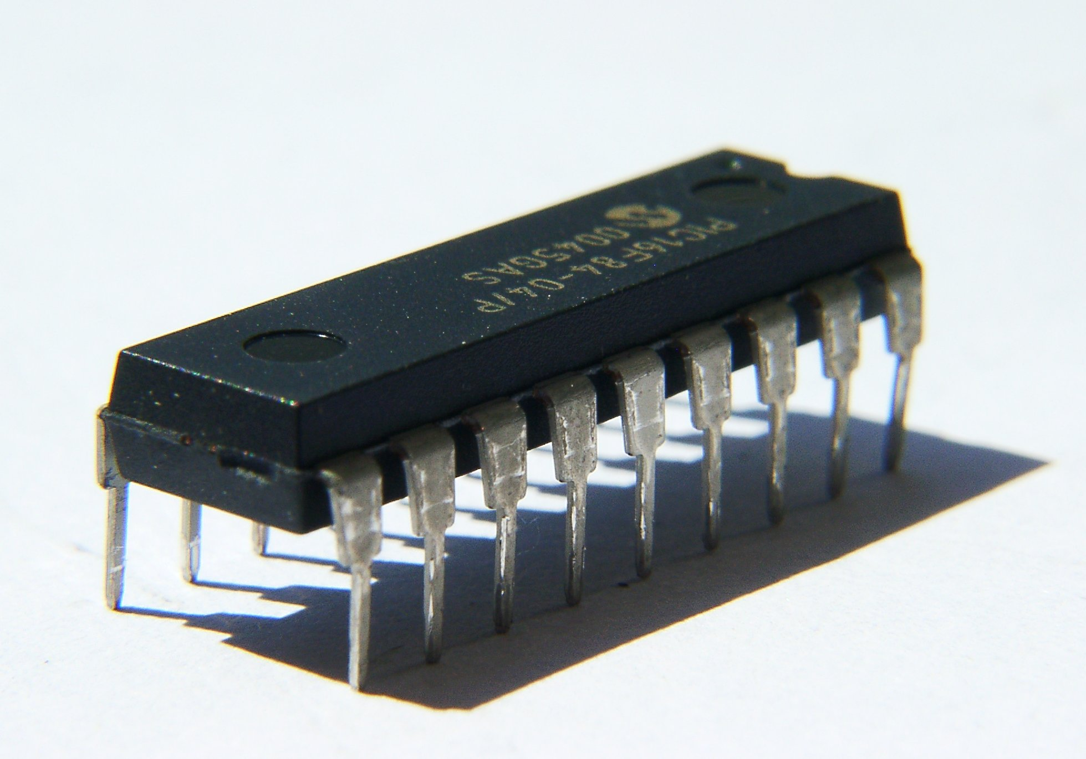
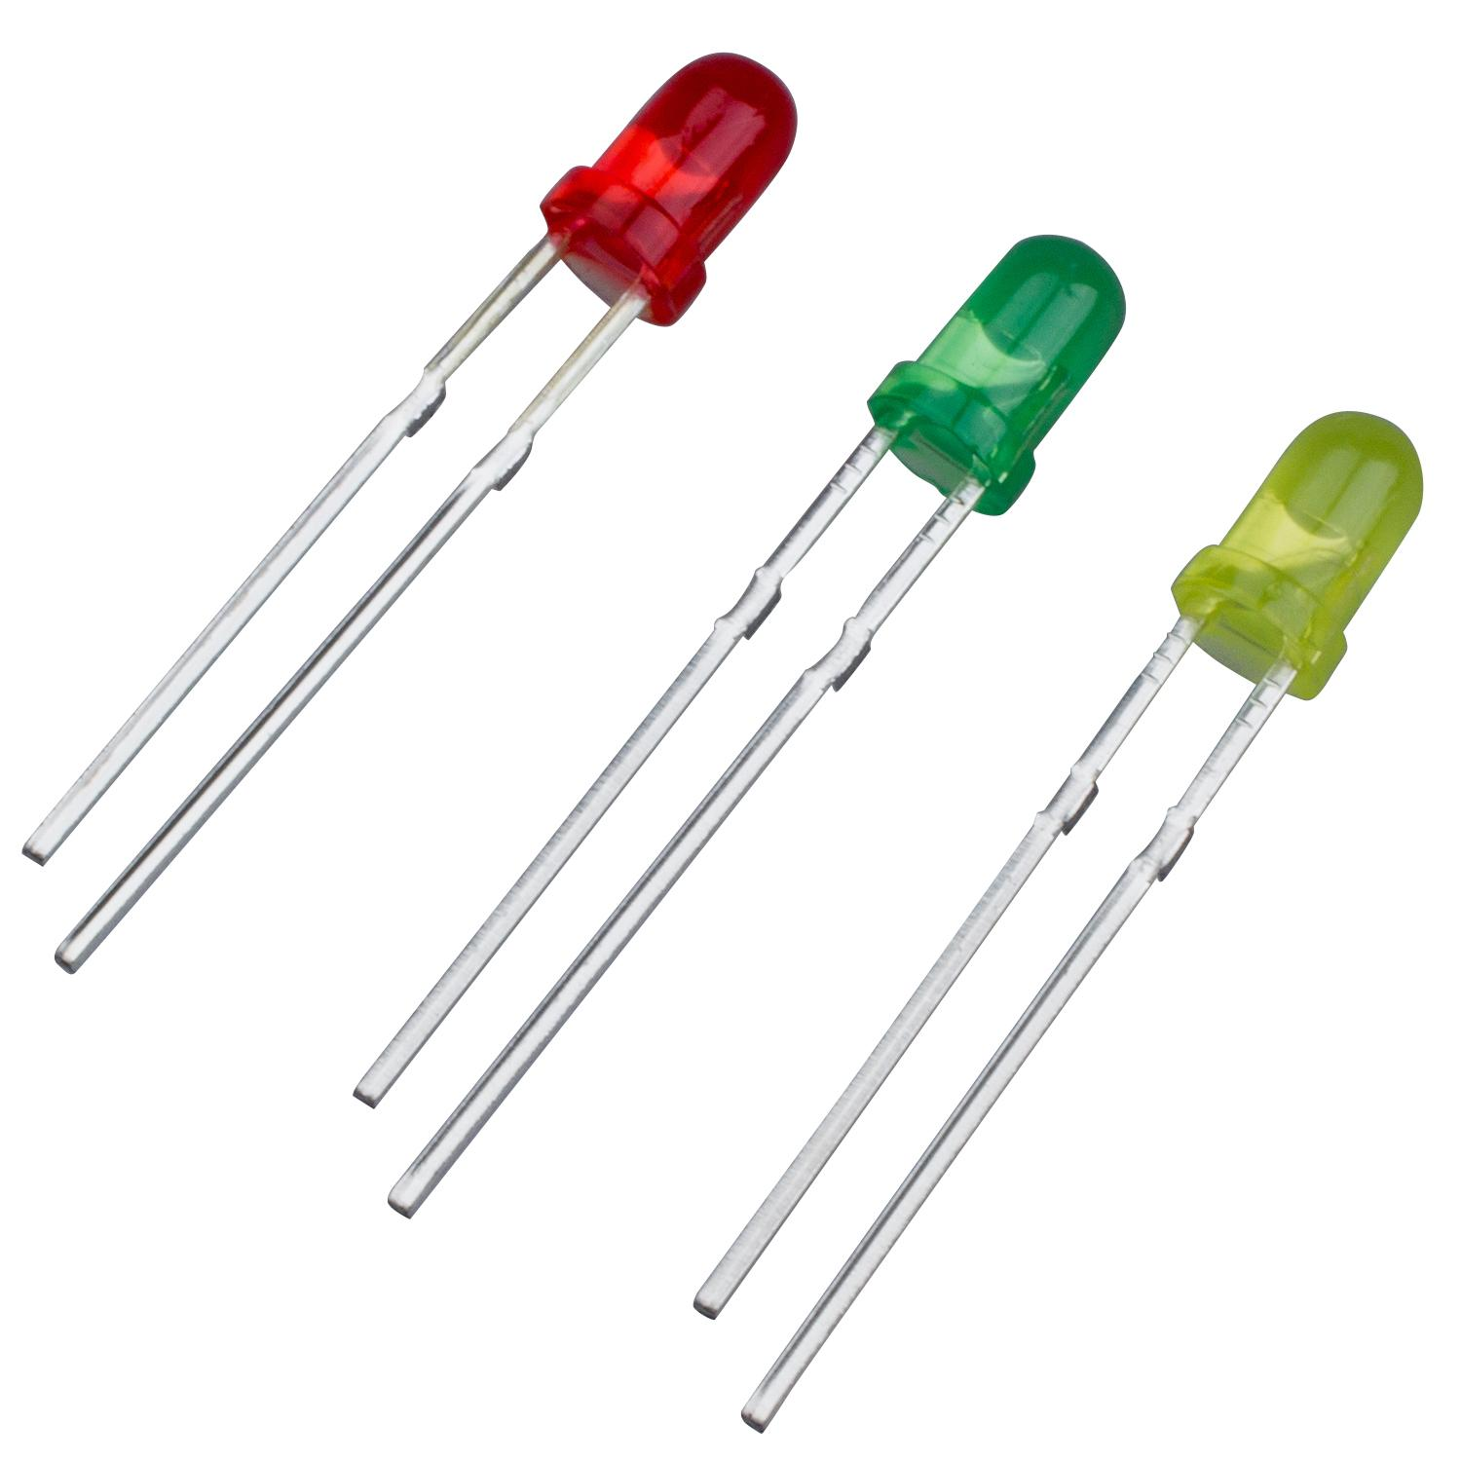
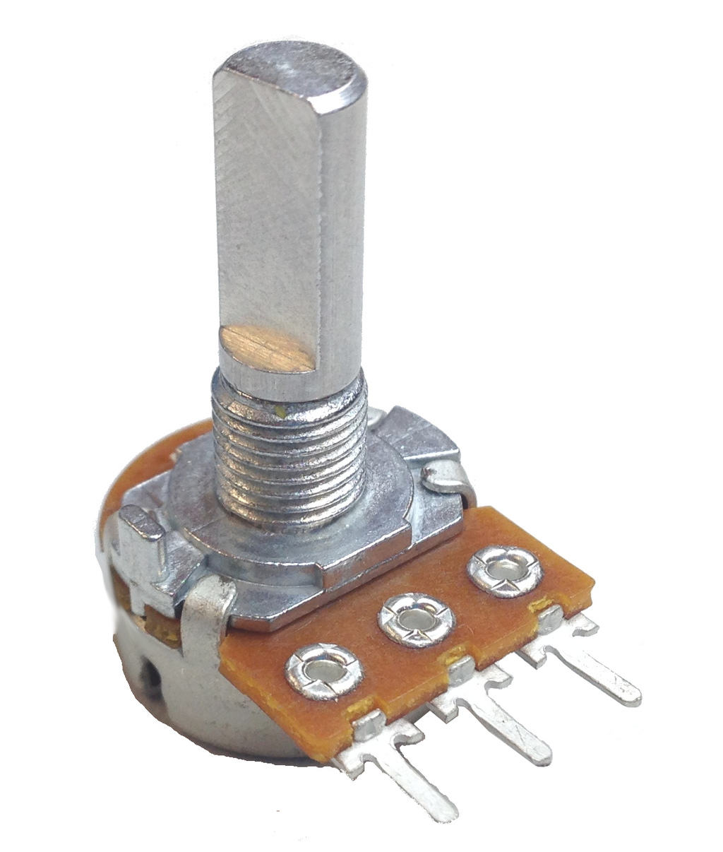
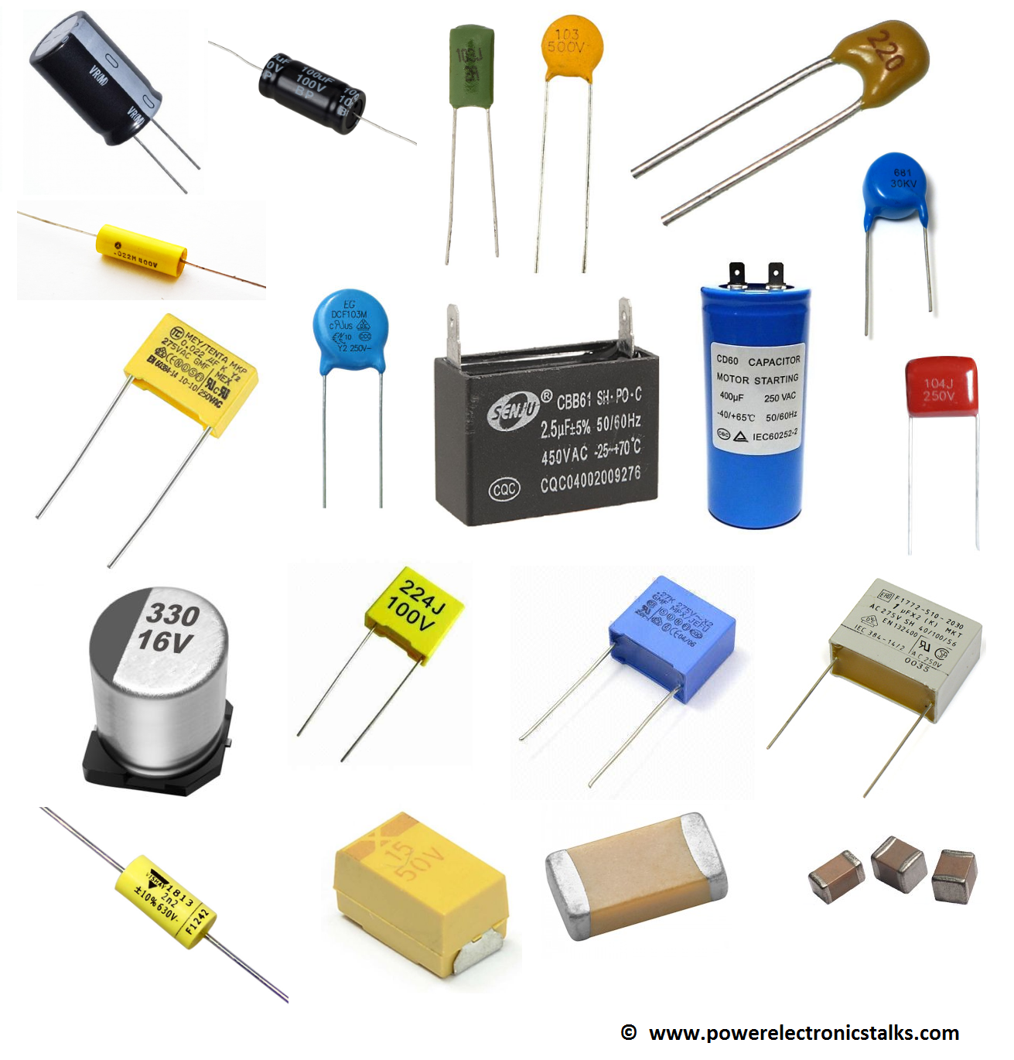
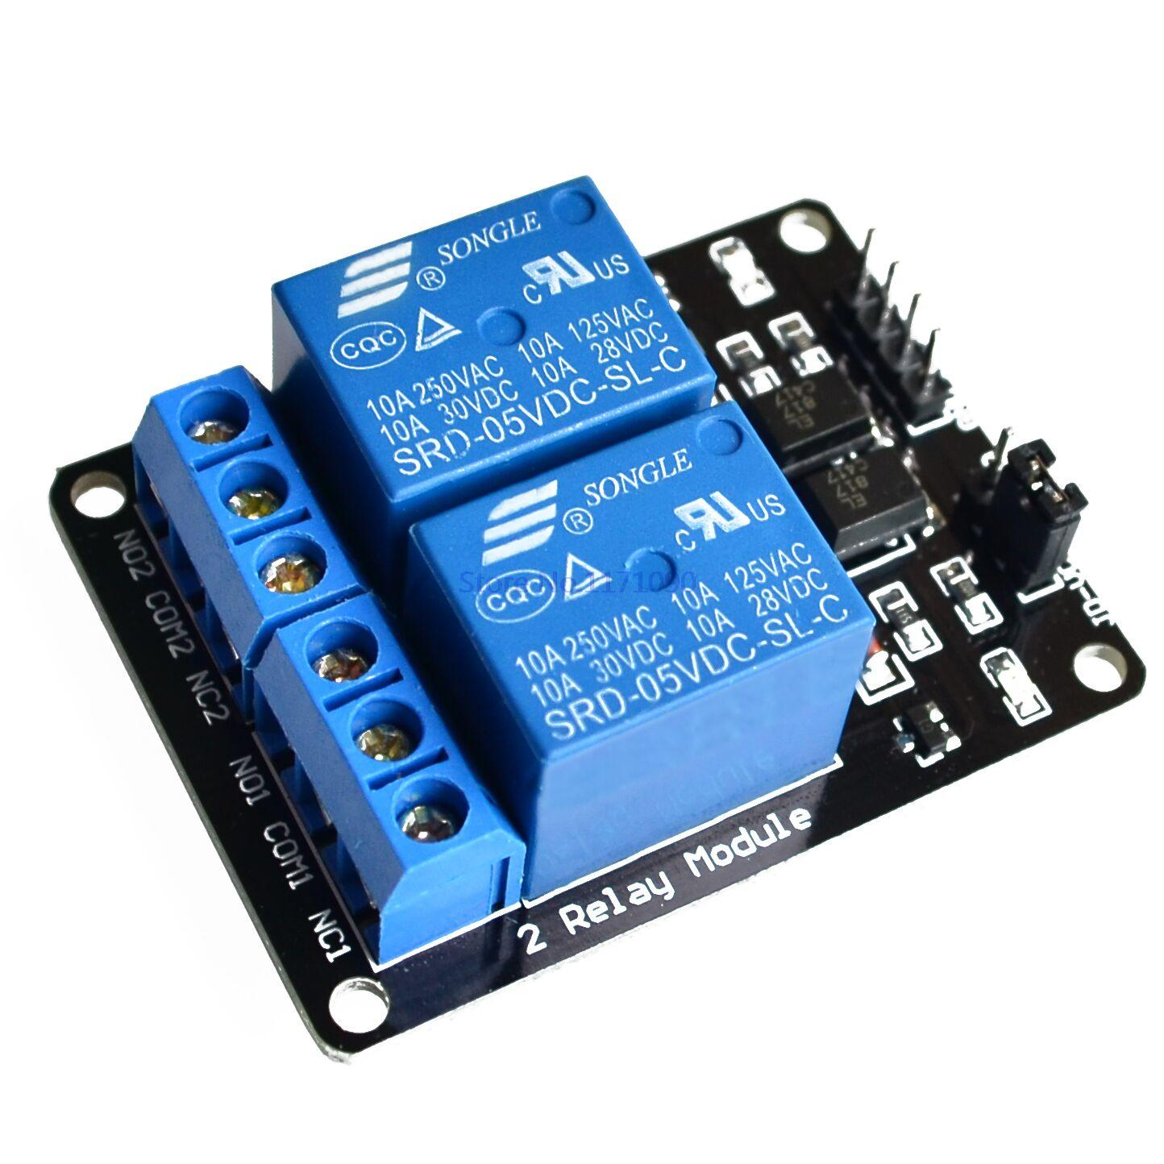
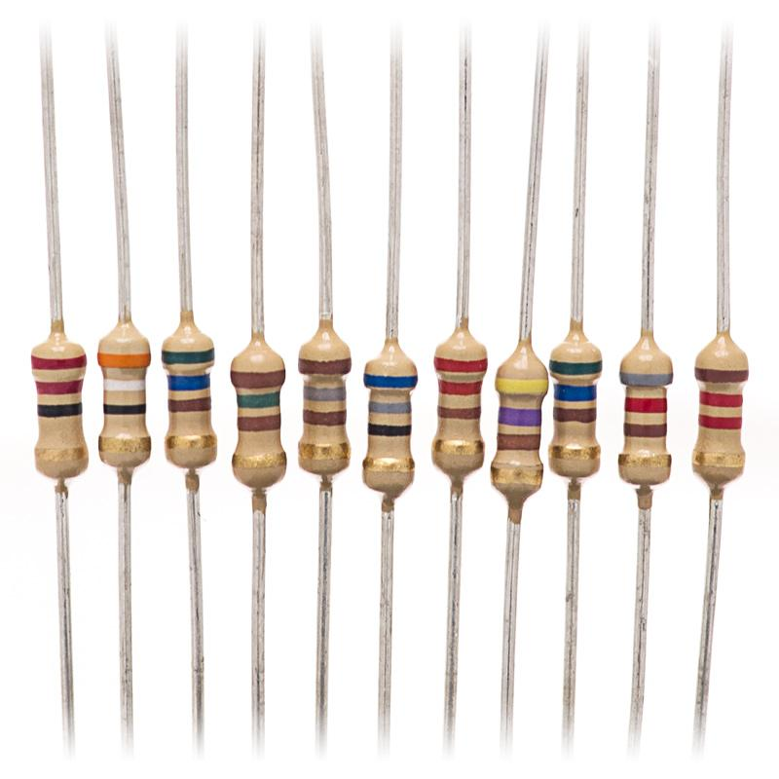
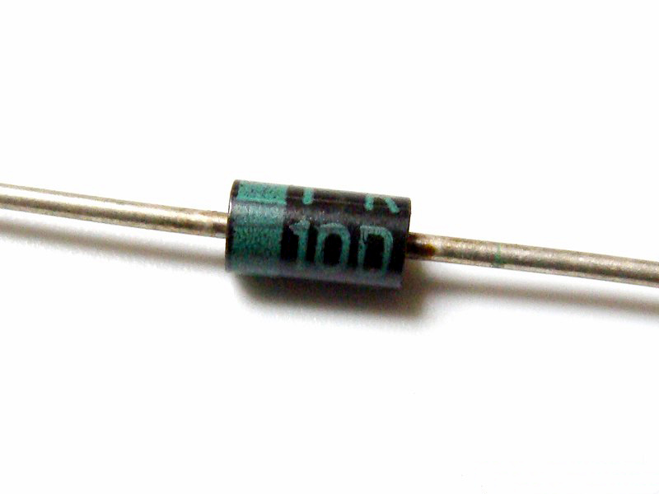
Common things found in circuits
Circuito
integrado
Servo
Transformador
Interruptor
Inductor
LED
Relevador
Diodo
Potenciómetro
Resistor
Capacitor

Slide 6
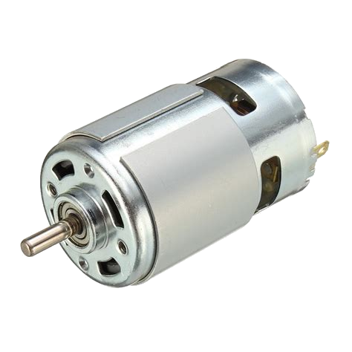
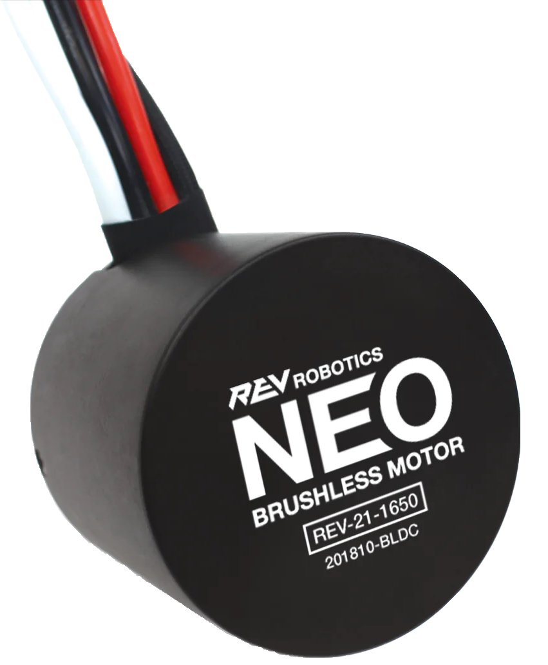
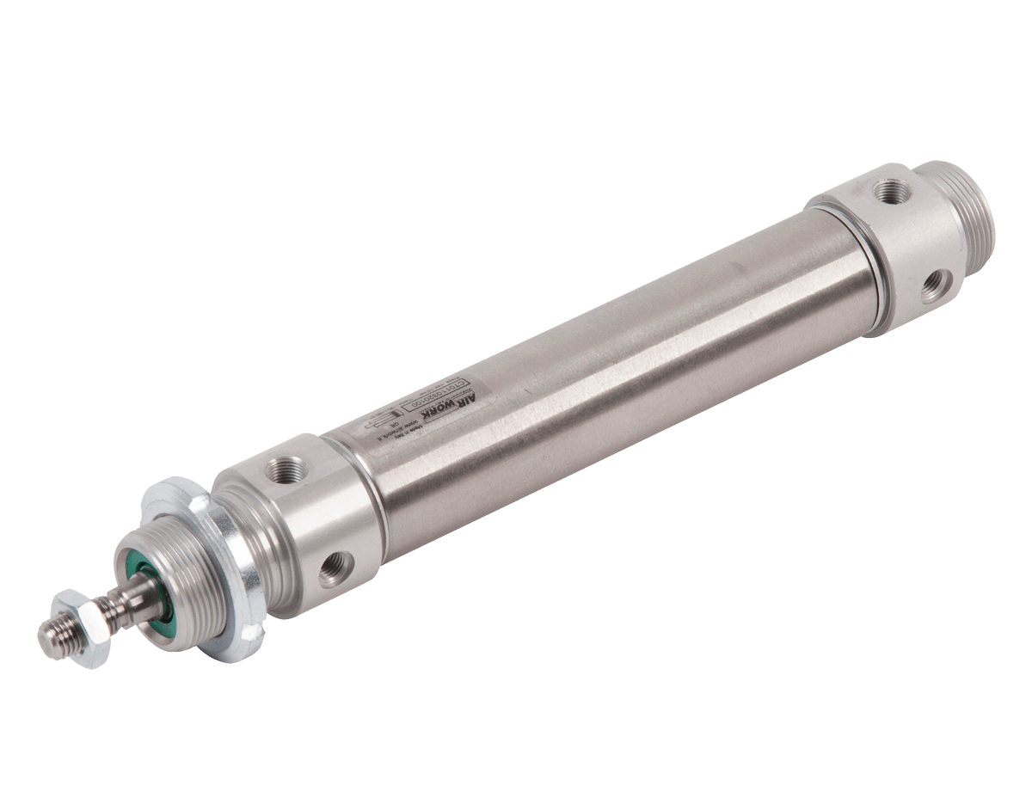
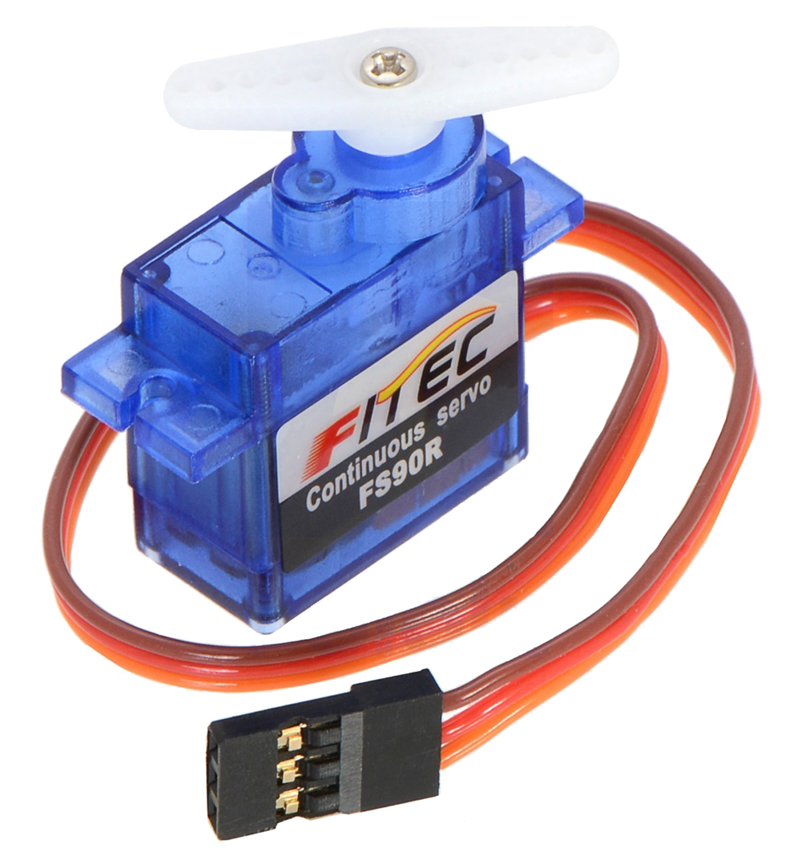
Actuators
An actuator acts on something such as wheel a gear, etc.
Actuators are things that move things and that can be controlled by a computer, eg. a motor, a piston, o servo.
They are all kinds of actuators that are represented differently in code.
boolean double

